Slide 1


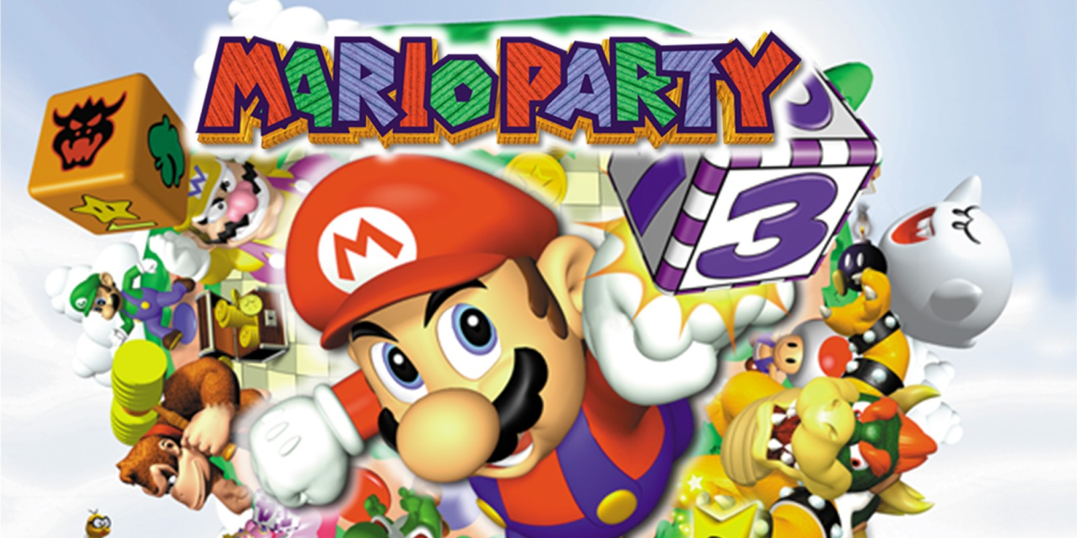
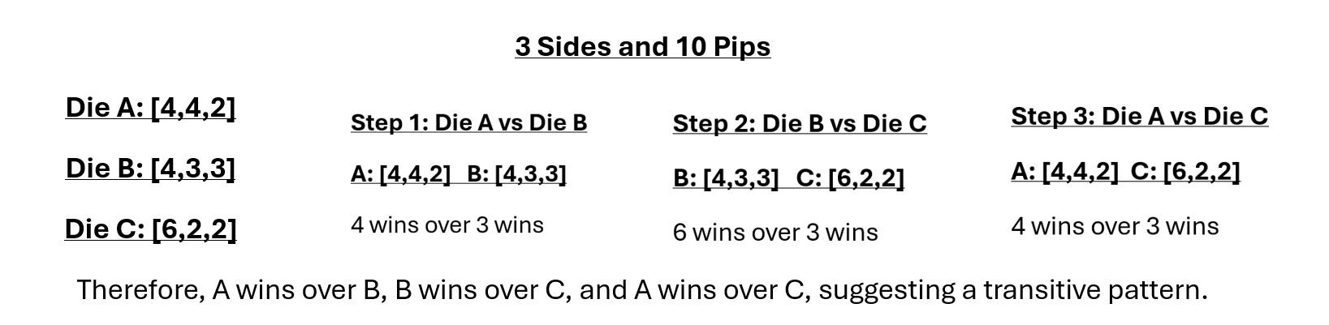
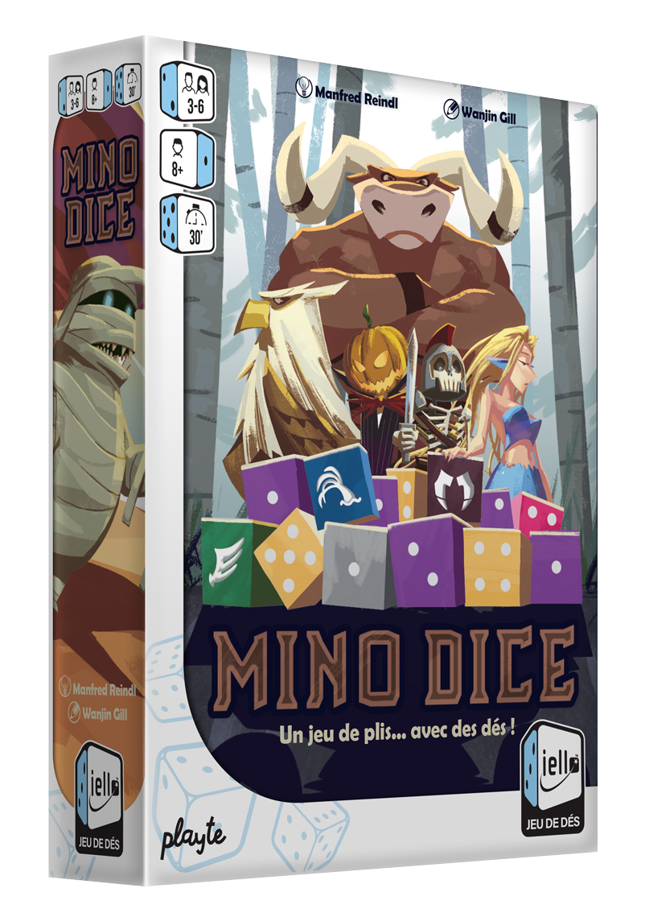
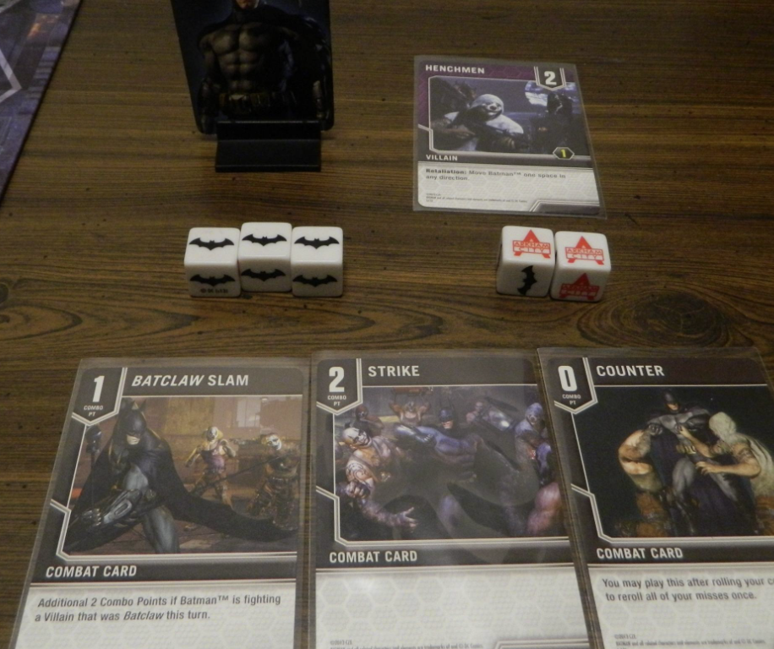
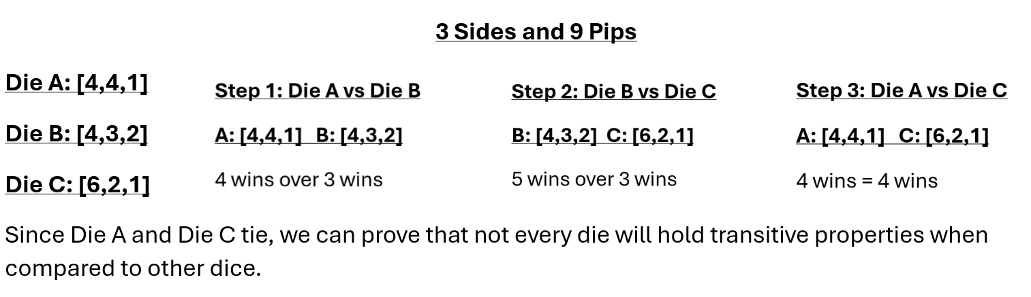
Analysis of Optimal Die Configurations
Mary Kait Heeren, Dr. Jeremy Becnel
Department of Computer Science, Stephen F. Austin State University
Abstract
More Dice Comparisons
Counting Dice Recursively
This exploration aims to analyze the mathematical intricacies involved in constructing dice with n faces and k pips, with a focus on combinatorial analysis. The initial motivation stemmed from developing a Python program to generate and compare dice configurations. This program is a practical tool for visualizing die combinations, leading to a deeper investigation into related mathematical concepts.
The investigation uses an algorithm to construct all possible dice and compares the die to determine the optimal configuration, which is the configuration with the highest probability of winning. Additionally, we explore properties of the die including the concept of transitivity in dice relationships.
Definition. Given two dice A and B with the same number of sides, a die A is said to win over another die B if given every pairing of sides (a,b) where a is from A and b is from B, the majority of the pairing satisfy a > b.
Given a dice with 3 sides and 9 pips to divide over the sides. We can generate the possible combinations.
[5,3,1],[4,3,2],[6,2,1]
Therefore, when compared…
[5,3,1] & [4,3,2]: TIE
[4,3,2] & [6,2,1]: [4,3,2] wins
[5,3,1] & [6,2,1]: TIE
Therefore, this example demonstrates that there is not always a maximal die given a specified number of sides and pips. Not one of the three dice win consistently over the others thus disproving the theory that there will be a dominant or maximal die for every number of sides and pips.
Base Case: if the number of pips is less than the number of sides, then no dice are created since you cannot have a side without pips. Similarly, only one die is generated in the case that a die has an equal number of sides and pips, since each side can only have one pip.
Recursive Case: In this case, we use a minimum and maximum number that we can use to generate the number of pips for the first side. By using math.ceil(pips/sides) to set a lower bound on possible pips and a high bound of the previous pip (first pip of the previous iteration) or pips – sides + 1, this limits the possible values that pips on the first side of the die can take. For each possible value generated, the program recursively calls the method with sides minus one and pips minus pips generated for the first side. The pips from the first side are passed as the new previous pip as a check to ensure the current die’s value is not exceeded.
As an example, lets solve n = 3 and k = 5.
Finding the Lower and Upper Bound:
Lower: Ceiling of Pips/Sides: 2
Upper: Pips – Sides + 1: 3
Therefore, the dice will start with [2, _, _], [3, _, _].
Repeat for each of these with parameters sides – 1 and total number of pips minus pips for the first side, as well as the first pip from the previous iteration.
For first pip = 2,
Lower = 2, Upper = 2, so we have [2,2,_]
For the next first pip,
Lower = 1, Upper = 1, so [2,2,1] = 1 die.
For first pip = 3,
Lower = 1, Upper – 1, so [3,1,_].
For the next first pip,
Lower = 1, Upper = 1, so [3,1,1] = 1 die.
Therefore, we have 2 possible dice generated when there are 3 sides and 5 pips.
Dice Games
Mino Dice: The dice decide who wins each round. Number dice roll numbers, and special dice (like Minotaur's and Griffins) beat the number dice based on a simple rock-paper-scissors-like system.
Mario Party: The dice mechanics combined with skill-based mini-games make Mario Party a blend of luck, strategy, and competition.
Batman: Arkham Chronicles: The game features dice-based mechanics where each roll can influence actions like combat, movement, or special abilities. Typically, the dice represent critical elements such as attacks, dodges, or actions that affect the outcome of battles against villains or completing mission objectives.
Transitivity Failure
A relation is transitive whenever one element is related to a second element, and that second element is related to a third element, then the first element is also related to the third element.
In terms of dice:
If Die A wins over Die B, and Die B wins over Die C, then for transitivity to hold, Die A should also win over Die C.
.
Therefore, transitivity is not consistent in dice comparison, disproving the theory that dice could hold transitive properties in every case.
Conclusion
Through the development of a python method for generating and comparing dice configurations, we observed transitivity does not universally hold amongst dice comparisons. We explored variations of comparison including “overall strength” versus “face-to-face” comparison and how outcomes will vary between both in regard to transitivity. We utilized recursion to explore and quantify the number of possible dice configurations.
Overall, this research highlights the complexity of dice analysis that range from applications in programming to combinatorics. These results suggest an unconventional nature of dice and open the door for further investigation into the behavior of dice and their application in different environments.
Contact
Acknowledgements
References
Mary Kait Heeren
Department of Computer Science
P.O. Box 9837, SFA Station Nacogdoches, Texas 75962
heerenmk@jacks.sfasu.edu
This research was supported by the College of Sciences and Mathematics as part of the Undergraduate Research Experience at Stephen F. Austin State University. I’d like to extend a thank you to Stephen F. Austin State University and Jeremy Becnel for providing an opportunity to get involved in a Research Experience, as it has been an insightful and rewarding process.
Thank you to the Computer Science department for the workspace and the equipment used throughout the entirety of the project.
A special thanks to Dr. Nicolas Long for the concept of dice combinatorics that this project is based on.
1. Jupyter Notebook (Project Jupyter | Home)
2. Geeks for Geeks (Transitive Relations: Definition, Properties, and Examples (geeksforgeeks.org))
3. Github Repository (SFA-CS/DiceProblem)

